Slide 1
United Airlines Safety Analysis and Recommendation Executive Summary
Term Project Milestone 2
Kesav Adithya Venkidusamy
Bellevue University
DSC 640 – T301 Data Presentation and Visualization
Professor: Catherine Williams
Due Date: 07/03/2022

Slide 2
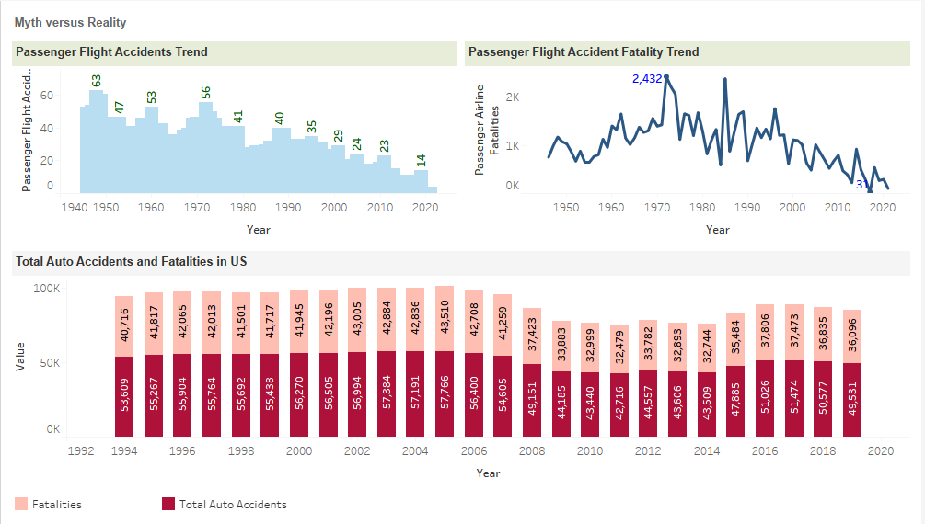
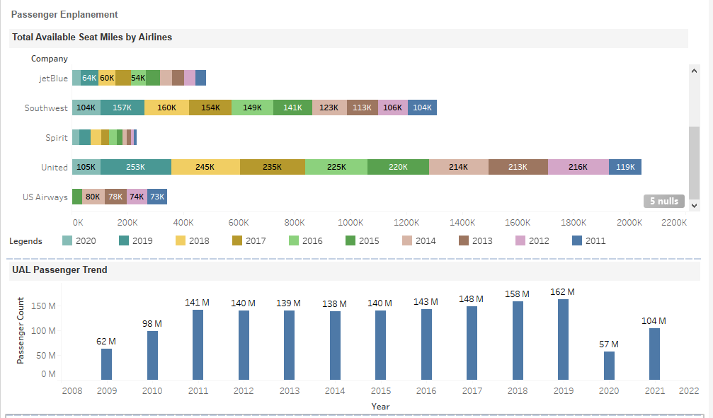
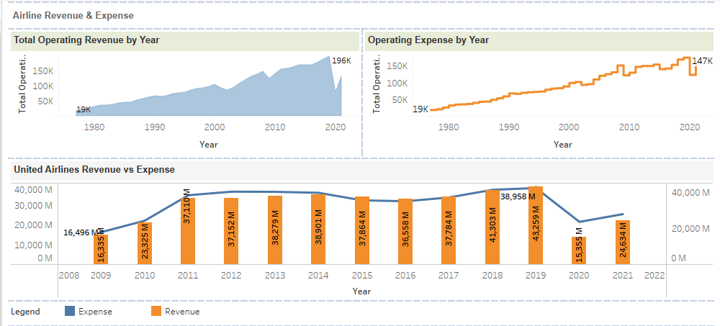
Summary
Myth vs Reality
Media spreading rumors about Airline Safety concerns versus Statistical data
Passenger Enplanement
Increase in passenger enplanement and available seat miles
Airline Revenue
Covid Impact and increase in revenue over years
Operating Cost
Impact to income due to increase in operating cost
Recommendations
What did stats say?
Legal and Ethical Considerations
Data Authenticity and compliance
References
Data Sources
Revenue Improvement

Slide 3
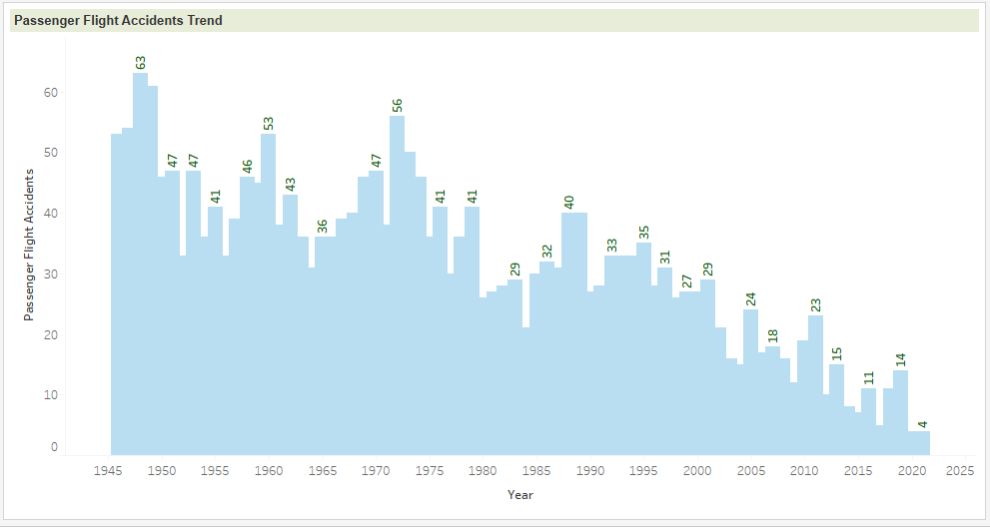
Myth vs Reality Chart Showing Total Passenger Airline Accident over years
Media promoting statistics stating air travel is no longer safety
However, the data shows the passenger airline accidents is decreasing over the year throughout the world
Source: Google Document

Slide 4
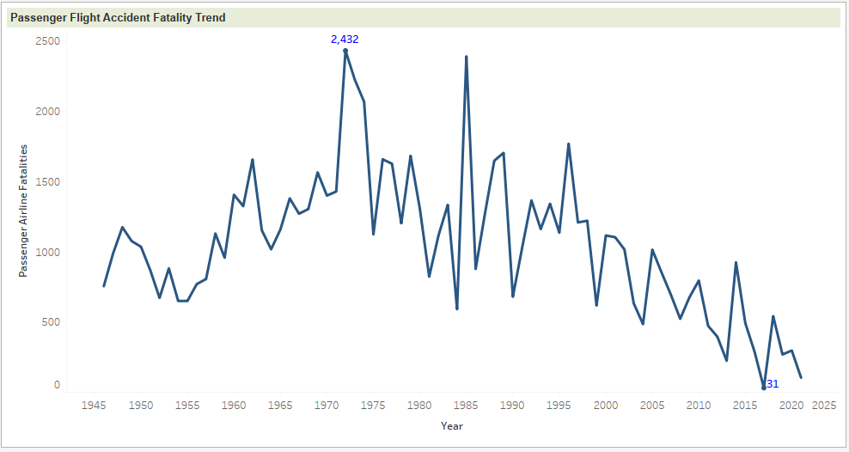
Myth vs Reality Chart showing Passenger Airline Fatality over year
The chart shows the airline fatality count decreases over time.
The fatality count is very less; less than ~0.5 fatality occurred / Millions of flights scheduled in 2019 to 2021 throughout the globe
Source: Google Document

Slide 5
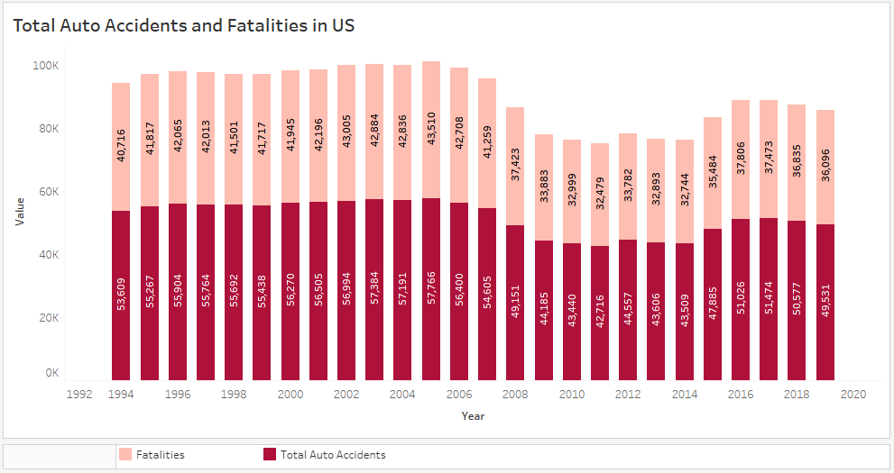
Myth vs Reality Chart showing Auto Accidents and Fatality Trend
This chart shows the auto Accidents and fatality over time in USA.
Total accidents and fatalities for the automobiles is around 50K and ~36L respectively. This number is only for US country
Comparing the charts, Airline reported accidents and fatalities was way less and not comparable to total ground accidents and fatality reported in US alone
Source: https://www.nhtsa.gov/

Slide 6
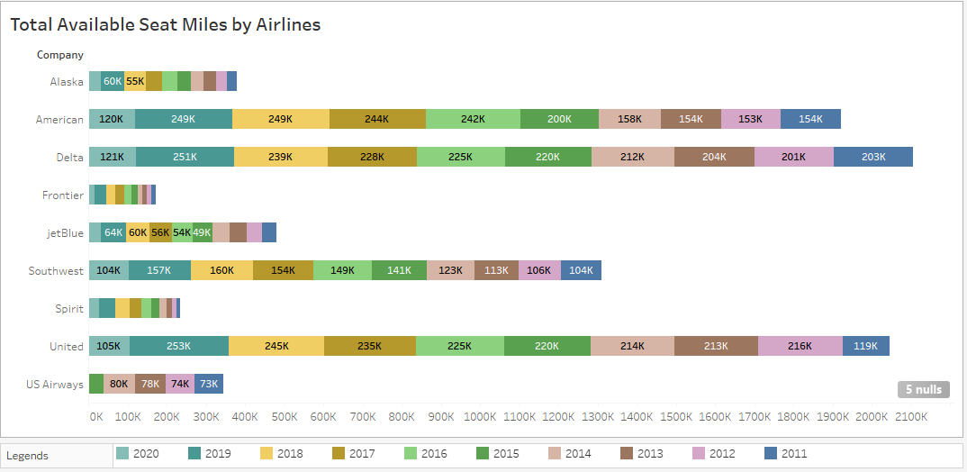
Passenger Enplanement Charts showing total Available Seat Miles Per Airlines
The chart shows the available seat miles has been increased considerably across airlines
United Airlines shows increase in seat miles Pre-Covid (2011 to 2019) and the drop in 2020 is due to Covid situation
Source: http://web.mit.edu/airlinedata

Slide 7
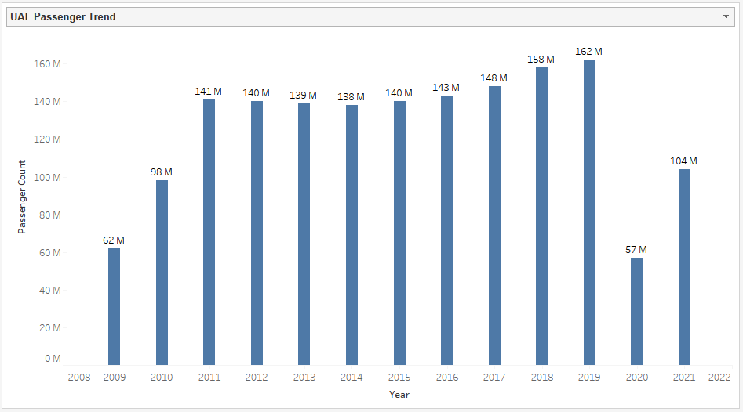
Passenger Enplanement Charts showing Passenger Travelled in UAL over years
The total passenger travelled in United is gradually increasing over years from 2009 to 2019
Impact in 2020 due to Covid.
Based on the data, it is clear that passengers travelled in United and other airlines is increasing year over year
Source: https://expandedramblings.com/index.php/united-airlines-statistics-facts/

Slide 8
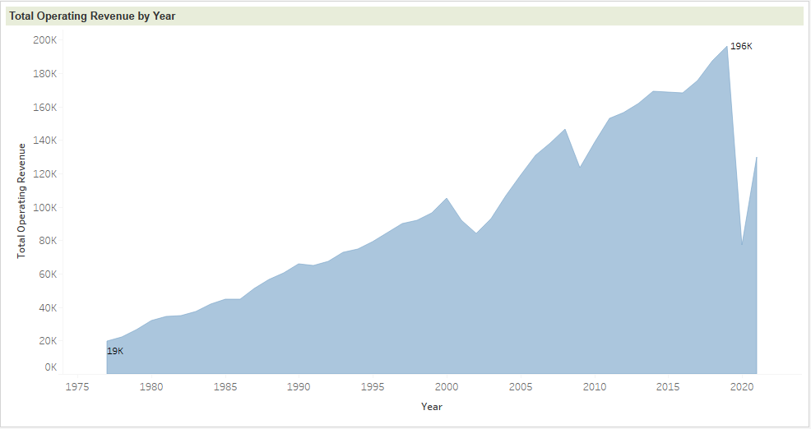
Airline Revenue Charts showing airlines revenue over years
Charts shows that airlines operating revenue increases over the period.
Due to travel restrictions for Covid, the revenue is impacted for all airlines in 2020
Source: https://catalog.data.gov/

Slide 9
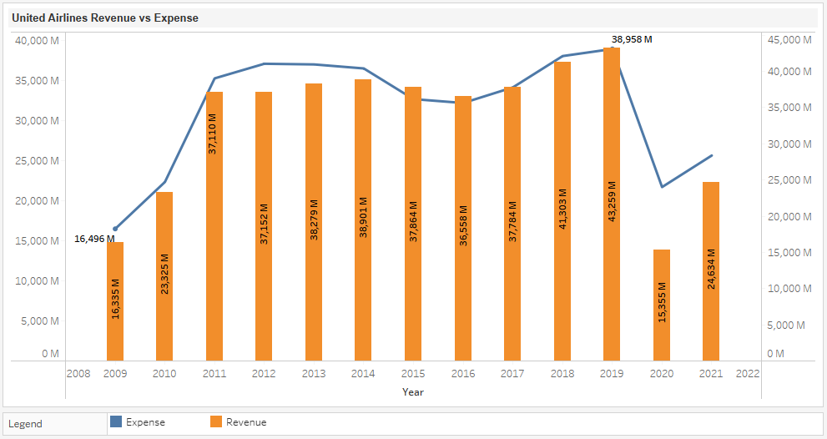
Airline Revenue Charts showing United Airlines revenue and Expense for past decade
Similar to other airlines, United Airlines revenue has been consistently increases over the years in last decade
Though revenue is impacted due to Covid in 2020, the revenue started to regain back to 2019 levels.
Management is confidence in long term targets of achieving pre-tax margin targets of 9% 2023 and 14% in 2026
Source: https://www.macrotrends.net/

Slide 10
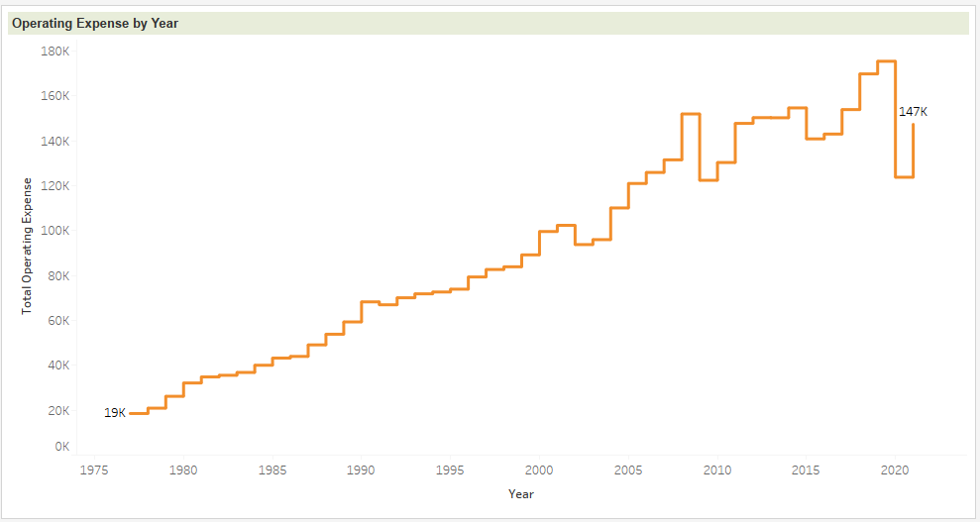
Operating Cost Charts showing Operating expense of airlines over year
As revenue increase, the operating expenses also increased over time
Post Covid, Worldwide Inflation is impacting Airlines operating expenses
Management should focus on controlling Operation expenses by promoting more automation
Source: https://catalog.data.gov/

Slide 11
Recommendations What did stats say?
Airline reported Accidents and Fatality (worldwide) was very less and non comparable than the total number of ground accidents and fatalities reported in USA alone
Management needs to focus on controlling the operating expenses by promoting some automations
As Covid restriction eases, the people willing to travel surges. So, management should focus on increasing the fleet capacity for 2022 and 2023 to overcome the loss incurred during covid
Management can attract more passengers by providing some offers and compliments

Slide 12
Legal and Ethical Considerations Data Authenticity and compliance
No Personal Identifiable Information (PII) and confidential data are used for Analysis
The data considered for the analysis are shared by government for public benefits
All data sets are extracted from public websites. The data source used for each chart has been mentioned in the respective slide (below the chart)
There is no restrictions to use this data for Analysis and academic purpose
Only relevant information required for this analysis is considered

Slide 13
References Data Sources
Accidents and fatalities:
https://docs.google.com/spreadsheets/d/1SDp7p1y6m7N5xD5_fpOkYOrJvd68V7iy6etXy2cetb8/edit#gid=1448957446
https://www.nhtsa.gov/data
http://www.baaa-acro.com/statistics
Passenger Enplanement:
https://expandedramblings.com/index.php/united-airlines-statistics-facts/
Revenue and Operating Expense:
https://www.airlines.org/impact/
https://www.macrotrends.net/stocks/charts/UAL/united-airlines-holdings-inc/operating-expenses
https://catalog.data.gov/

